Slide 1
Fullstack (Web)Development

Slide 2



What is a stack?
Notes:
Tell me what you see…
Stack is a composite structure that is built with smaller structures that are placed one upon another.

Slide 3
A typical web application
Front End
Back End
Notes:
What is the front end of a Television? We can say as the remote, the various controls in the menu, volume up/down button..
What is the backend of the Television? Your LED panels, resistors and capacitors.
What is front end?
It is the part of the application that is visible and consumed by users. Or generally all the code that runs on the browser is the frontend. Additionally, its not just the code that runs, but also the tools that help the development of the front end code is added to the part of frontend.
What is backend?
Backend is the part of application, that enables the communication and storage with hardware. All the code that runs on the server is the backend.

Slide 4
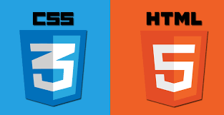




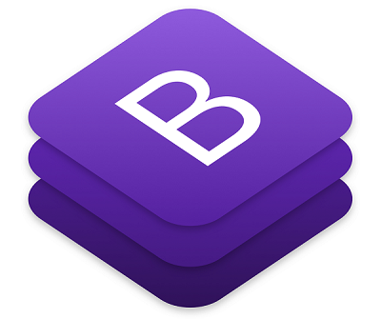








Slide 5














Slide 6







All about web application
1
2
5
3
4
8
7
6
Notes:
How does a web application work?
DNS resolution request for a domain.
DNS resolution response with the IP.
Web Request
Application Request
External request/responses
DB queries/responses
Application response
Web response

Slide 7
All about web application
Serves document from a centralized server.
Server is identified by a URI, which in turn maps to an IP address
Uses HTTP as the application level protocol, a stateless protocol.
Uses TCP as the underlying transport, a stateful protocol.
Renders output as HTML
Uses web browser for displaying the User Interface.

Slide 8
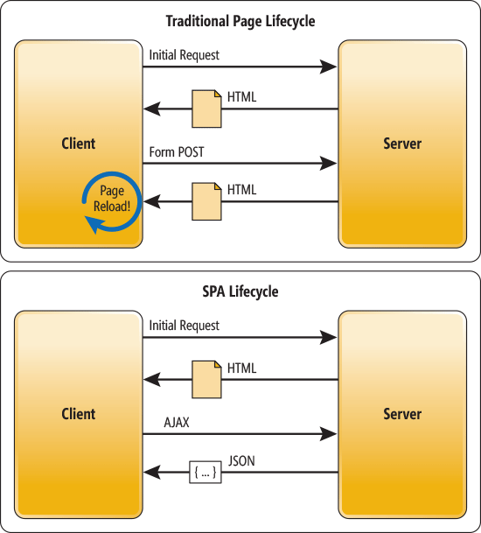
Traditional vs Single Page Web application
Notes:
Explain
AJAX
REST API

Slide 9

Front End
User Interface Layer[HTML/CSS/Javascript]
Validation and Business Logic Layer
Communication Layer
Back End
Communication Layer
Validation and Business Logic Layer
Persistence Layer

Slide 10
JARGON QUIZ

Slide 11
Notes:
New HTML standard:
New semantic elements like <header>, <footer>, <article>, and <section>.
New attributes of form elements like number, date, time, calendar, and range.
New graphic elements: <svg> and <canvas>.
New multimedia elements: <audio> and <video>.
CSS3 is the latest evolution of the Cascading Style Sheets language.
Enables rounded corners, shadows, gradients, transitions or animations, as well as new layouts like multi-columns, flexible box or grid layouts.

Slide 12
Notes:
1. HTML to define the content of web pages
2. CSS to specify the layout of web pages
3. JavaScript to program the behavior of web pages
All browsers support ES5.
All modern browsers support ES6
Latest version : ES9 - 2018

Slide 13
Notes:
jQuery is a fast, small, and feature-rich JavaScript library. It makes things like
HTML document traversal and manipulation,
event handling,
animation
Ajax
much simpler with an easy-to-use API that works across a multitude of browsers

Slide 14
Notes:
These are Javascript frameworks that enable us to create websites easily.
They provide
Databinding
DOM manipulation, without touching the DOM.
Routing
Templating engines
http clients for AJAX/ REST calls

Slide 15
Notes:
Bootstrap is an open source toolkit for developing with HTML, CSS, and JS.
It enables to prototype your ideas or build your entire app with our Sass variables and mixins, responsive grid system, extensive prebuilt components, and powerful plugins built on jQuery.

Slide 16
Notes:
Sass is a CSS pre-processor.
Sass reduces repetition of CSS and therefore saves time.

Slide 17
Notes:
JavaScript that scales.
TypeScript is a typed superset of JavaScript that compiles to plain JavaScript.
Any browser. Any host. Any OS. Open source.

Slide 18
Notes:
Babel is a JavaScript compiler.
Use next generation JavaScript, today.

Slide 19
Notes:
Webpack is a module bundler. It packs CommonJs/AMD modules i. e. for the browser. Allows to split your codebase into multiple bundles, which can be loaded on demand.

Slide 20
Notes:
gulp is a toolkit for automating painful or time-consuming tasks in your development workflow, so you can stop messing around and build something.

Slide 21
Notes:
Application servers, that are capable of converting the HTTP packets to language specific objects.
They can also serve as web servers.

Slide 22
Notes:
Node.js is an open-source, cross-platform, JavaScript runtime environment that executes JavaScript code outside of a browser.

Slide 23
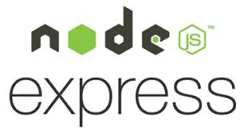
Notes:
Server side Frameworks that enable us to write web applications easily.

Slide 24
Notes:
Databases where the user data/configuration data is persisted.
Talk a bit on SQL, NoSQL

Slide 25
Notes:
Microsoft Azure is an open, flexible, enterprise-grade cloud computing platform.
Amazon Web Services offers reliable, scalable, and inexpensive cloud computing services.
It provides a readymade infrastructure which was earlier hand crafted and maintained by the individual application owners.

